Slide 1






Team Members
CSE-3
S.V.V.Hasini- 22L31A05J5
S.Aishwarya- 22L31A05J4
M.Yamuna- 22L35A0526
P.Monika- 23L35A0533
Project guide-
Mrs.P.Prathima Rani

Slide 2
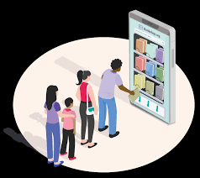
BOOK STORE
WEBSITE
“Book is a gift you can open again and again”

Slide 3

Project
Objective
Designing an intuitive and visually appealing frontend interface for a bookstore website and a platform for selling old books.

Slide 4
Technologies
Used
The languages we use
here are HTML,CSS and Java Script.

Slide 5
Uses
The main purpose of online bookstore is to provide a place for people to discover, explore, and purchase different types of written content.
It is convenient to select, buy and sell books online.
Easy accessibility

